Slide 1
Rocket Launch Animation

Slide 2
Group Members
Computer Graphics And Multimedia Lab (CSE 358)
Course Teacher
Ms. Tania Aker Setu
Assistant Professor, Department of CSE
Dhrubo Barua
Lecturer, Department of CSE
Name: Kayes Mahmood
ID: 2215151030
Name: Mubinul Islam
ID: 2215151041
Name: Redwanul Islam Rafi
ID: 2215151043

Slide 3
Objective
The objective of this project is to create an engaging rocket launch animation using computer graphics. It features a countdown, rocket takeoff, and space elements like stars, a nebula, and planets. The project aims to demonstrate graphical programming concepts and create dynamic visual effects.

Slide 4




Function
<graphics.h>
showCountdown( )
drawStars( )
drawNebula( )
The code uses the <graphics.h> header file for creating and manipulating graphical elements like shapes, colors, and animations.
Displays a countdown from 10 to 0 before the rocket launch, with a "Go!" message at the end.
Randomly generates stars on the screen, simulating a starry sky.
Randomly generates nebula-like patterns using colors such as red, magenta, and light magenta.
planet( )
blinkingStars( )
rocket( )
endingScene()
Draws planets with rings and small details like craters, simulating space.
Creates blinking stars that appear randomly on the screen.
Draws a rocket with details such as body, head, wings, and flames, then animates its movement.
Displays a "Thank you" message at the end of the animation.

Slide 5
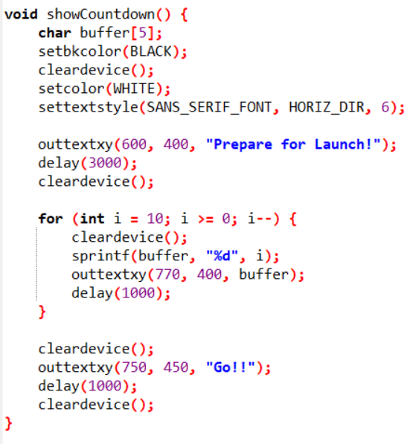
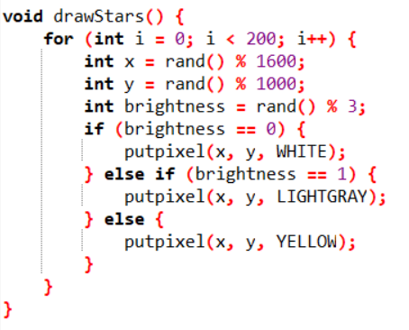
showCountdown( )
drawStars( )

Slide 6
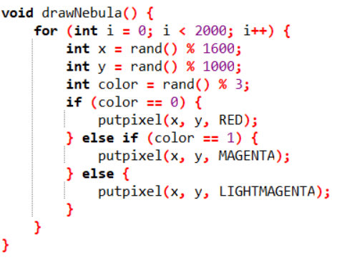
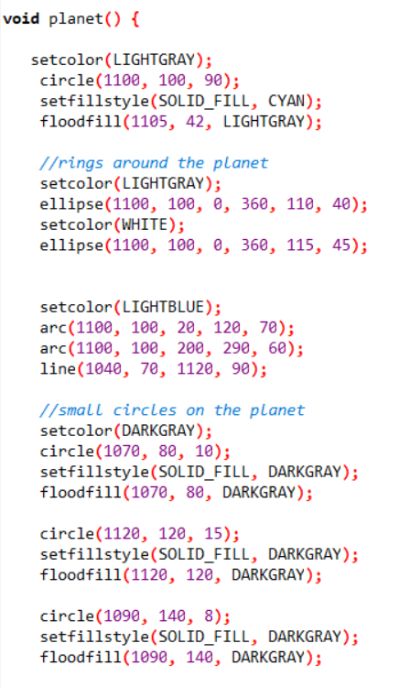
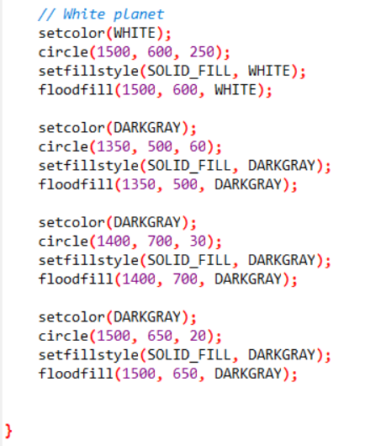
drawNebula( )
planet( )

Slide 7
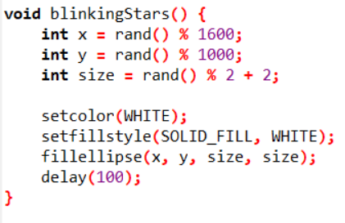
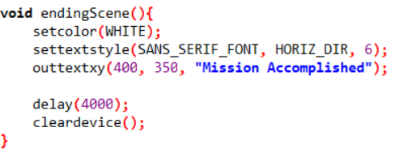
blinkingStars( )
endingScene( )

Slide 8
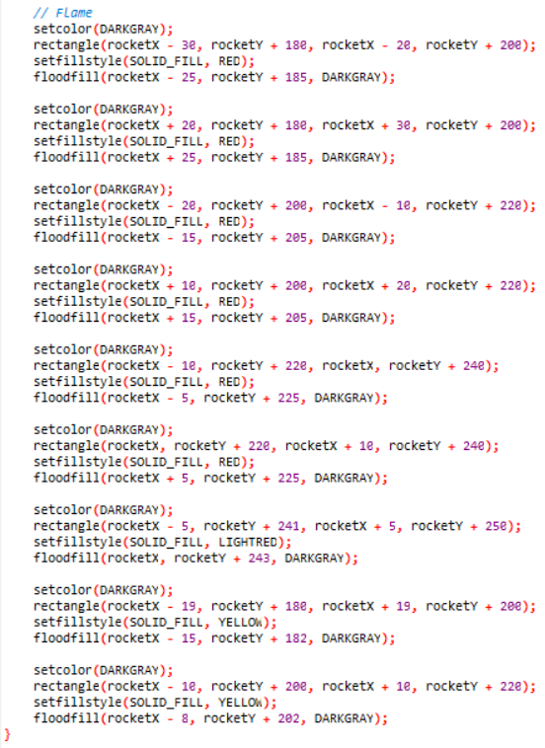
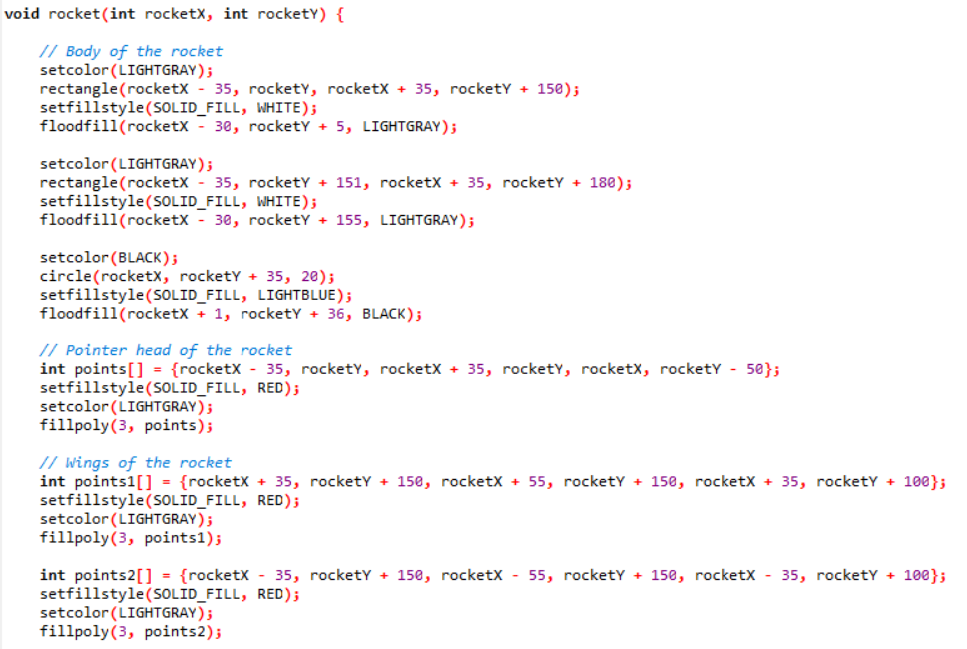
rocket( )

Slide 9

Project Overview

Slide 10
Conclusion
This project demonstrates an engaging rocket launch animation using computer graphics, featuring countdowns, stars, nebulae, and planets.
While a flickering issue remains unresolved, the animation successfully showcases key graphical programming concepts of computer graphics.

Slide 11
Mission Accomplished! Thank you for joining us on this journey to the stars!
Presented By:
Kayes Mahmood (ID: 2215151030)
Mubinul Islam (ID: 2215151041)
Redwanul Islam Rafi (ID: 2215151043)

